Slide 1
Internet of blockchains
Ethereum vs. Polkadot

Slide 2
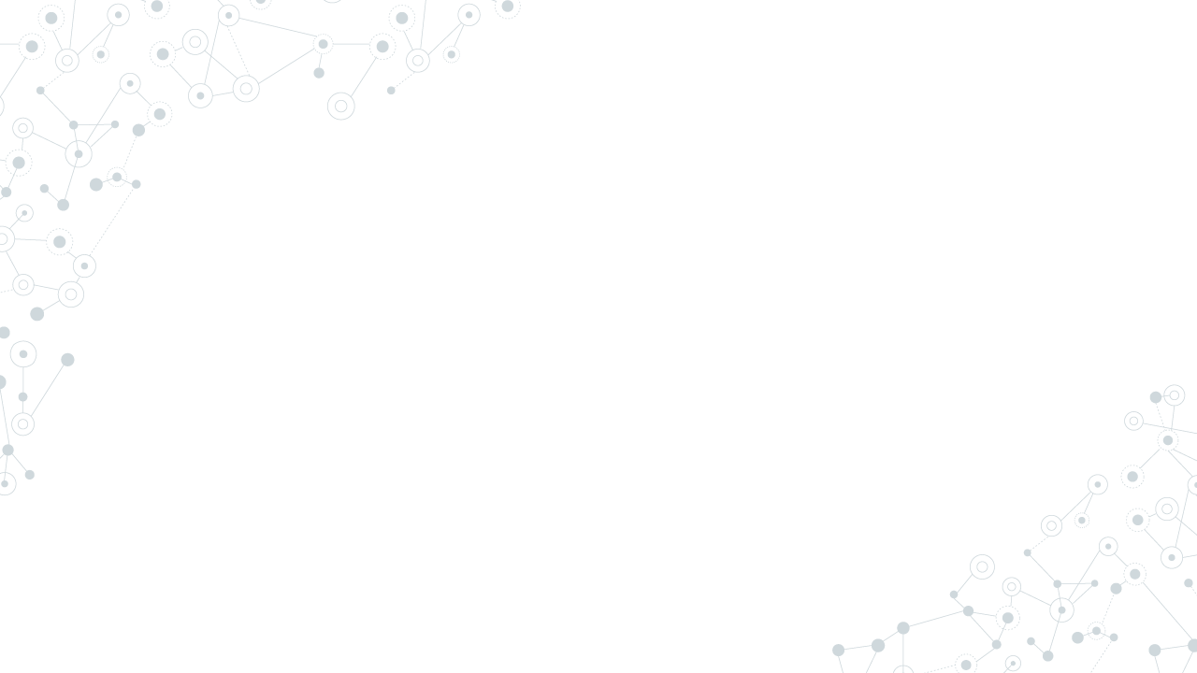

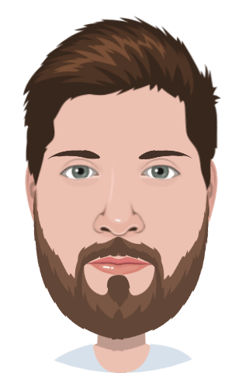



Petr Menšík
In crypto since 2017
Founder of Polkadotters
Polkadotters1
Polkadot CZ/SK

Slide 3
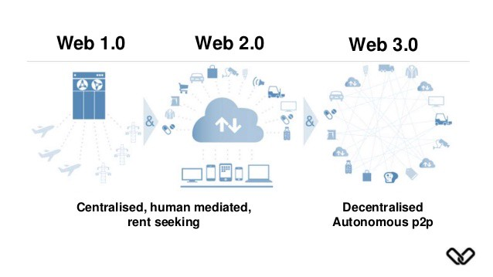
Why Web 3.0
Users no longer own their data
Black box algorithms control our lives
Internet and financial system is completely permissioned

Slide 4
The future of decentralized internet is multichain
Web3 Foundation

Slide 5
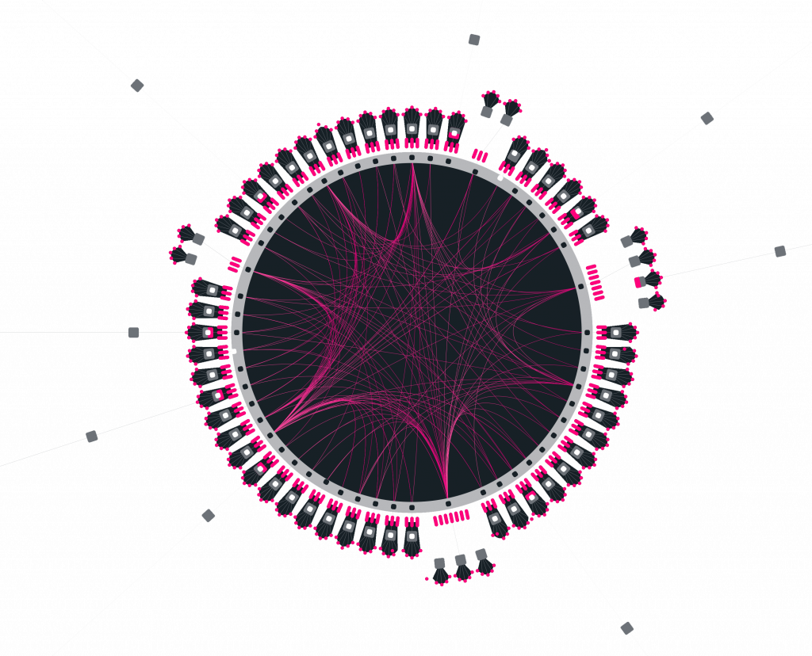
What is Polkadot and how does it help?
Built with Ethereum compatibility in mind
Platform for blockchain development
Support for bridges to other ecosystems
On-chain governance from the very beginning
Forkless upgrades

Slide 6
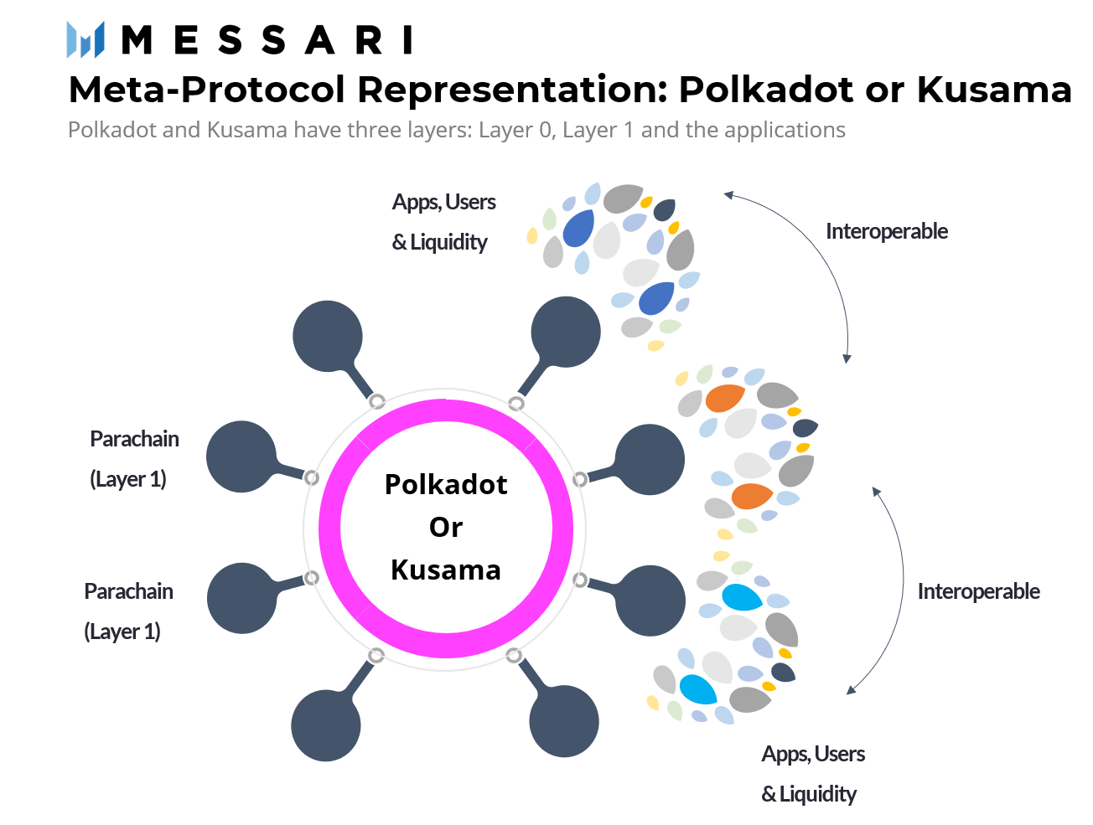
Parachains
Parachain vs Relay chain
Shared security
Independent economy and fee model
Built by Substrate framework

Slide 7



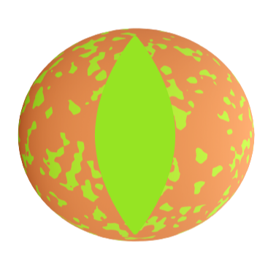



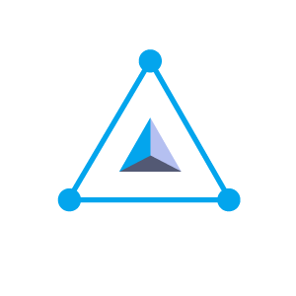


Parachains examples
Phala Network, HydraDX, Astar
Evolution from simple smart contracts
TEE data privacy technology as an examplee

Slide 8
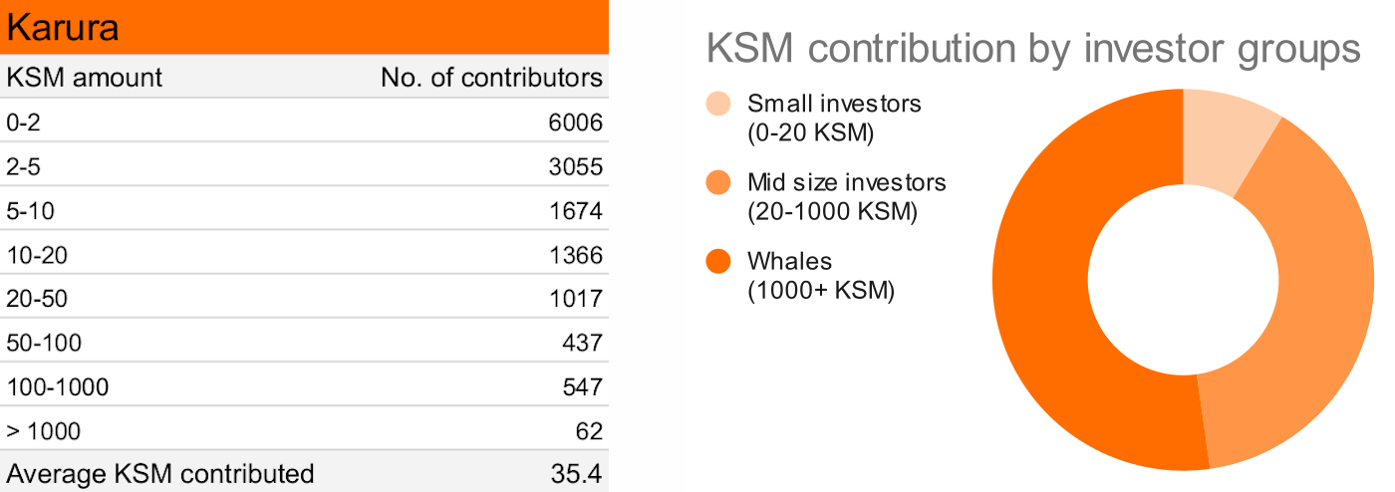
Auctions & Crowdloans
Parachain slots are limited
Candle auction
Crowdloan as a token distribution model
Other parachain types

Slide 9

Governance & forkless upgrades
Everything is voted on-chain
Multiple bodies (council, technical committee)
Anyone can propose changes and include them to the Polkadot chain

Slide 10

Kusama
Canary network
Real value
Testing ground for the parachain projects
Slowly evolving into its own direction

Slide 11


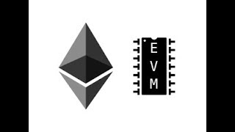
Polkadot & EVM
Parachains dedicated to the EVM compatibility
Moonbeam (Moonriver)
Astar (Shiden)

Slide 12
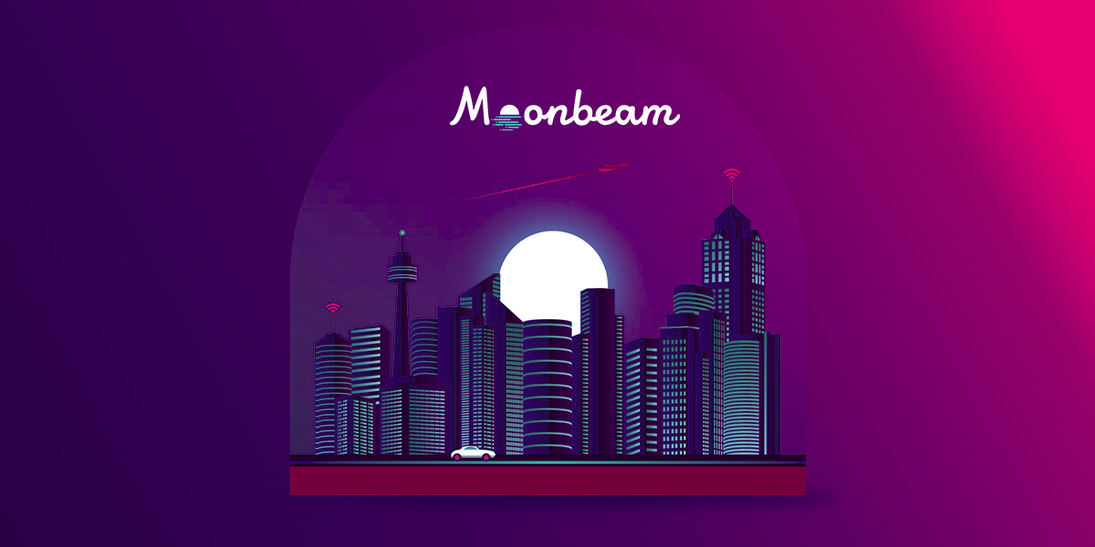
Moonbeam
100% EVM compatibility
On-chain governance
Publish-Subscribe model
Staking

Slide 13
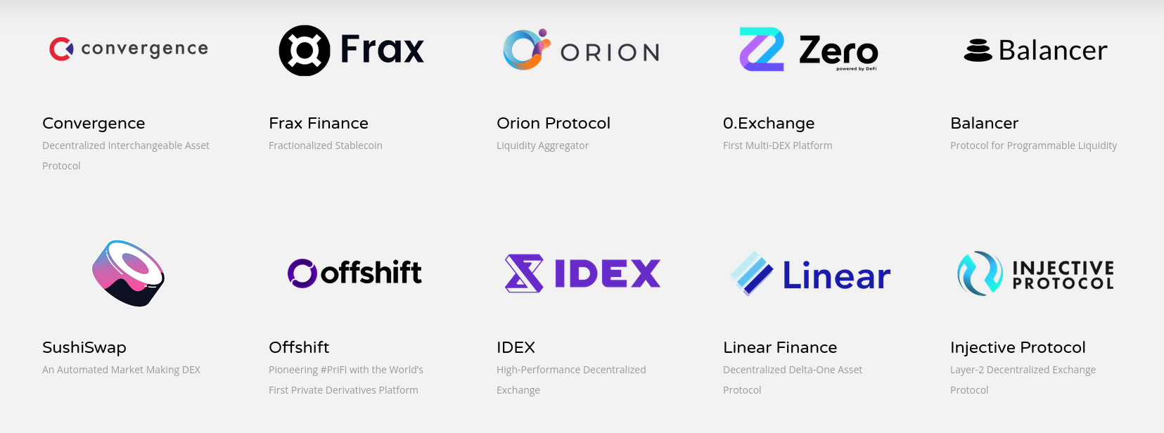
Partnerships
Strong hype around the project
Many partners already on-boarded
Ocean, Band, Lido
SushiSwap coming to Moonriver

Slide 14
250,000,000$
Already locked within the ecosystem
20,000+ tx
Transactions every day
2 months
Since the launch

Slide 15

Astar
100% EVM compatibility
Rust smart contracts (contracts common-good parachain)
Layer2 scaling support (Rollups and Plasma)
dApp staking

Slide 16
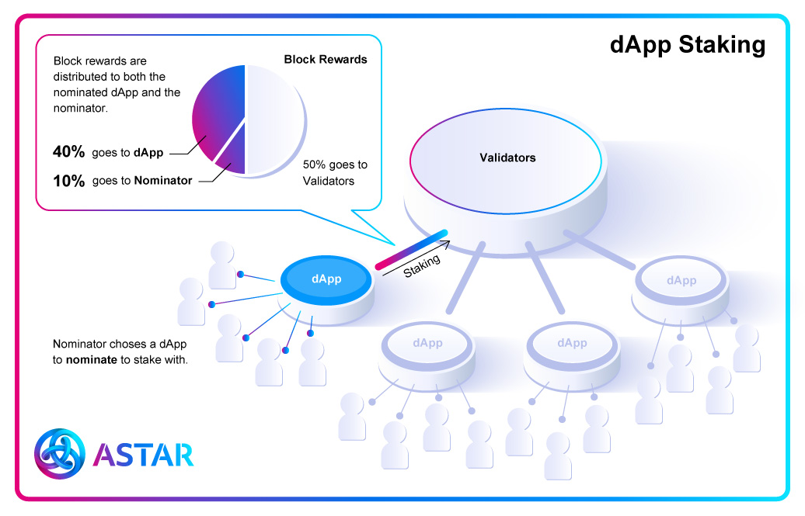
dApp staking
Users don’t nominate validators but dApps
50% of block reward
Basic income for developers

Slide 17

Composable Finance
Connecting L2 protocols
Various option for communication with L1
Experimental stable coin deployed on multiple L2 solutions

Slide 18
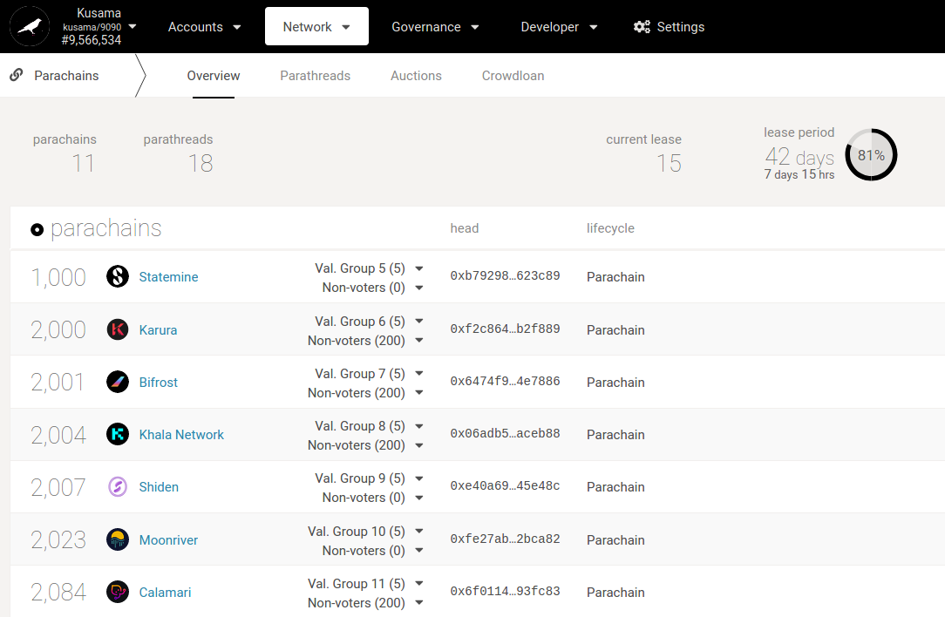
Current status & future
Kusama already running
Auctions on Polkadot
Further optimizations

Slide 19
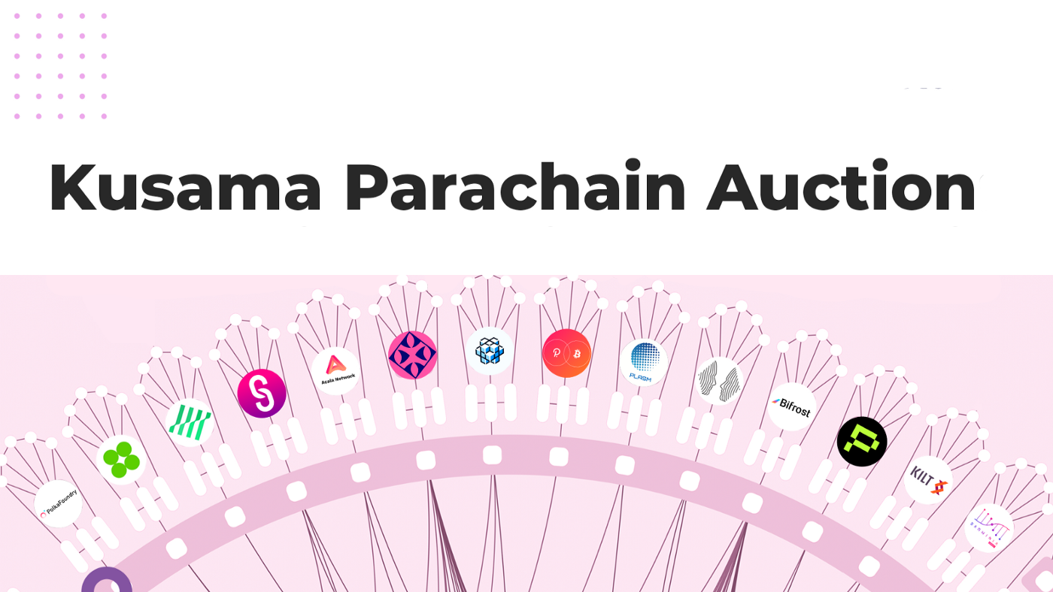
The end

Slide 20
Thanks!
Any questions?
You can find me at:
polkadotters@protonmail.com

